Slide 1
Rate of Change & Slope
Essential Question?
How do you find the rate of change (slope)?
8.F.4

Slide 2
Common Core Standard:
8.F.4 ─ Use functions to model relationships between quantities.
Construct a function to model a linear relationship between two quantities. Determine the rate of change and initial value of the function from a description of a relationship or from two (x, y) values, including reading these from a table or from a graph. Interpret the rate of change and initial value of a linear function in terms of the situation it models, and in terms of its graph or a table of values.

Slide 3
Objectives:
To find the slope (rate of change) of a linear function.

Slide 4
Curriculum Vocabulary
Rate of Change (tasa de cambio):
The ratio of vertical change (change in the dependent variable, y) to horizontal change (change in independent variable, x) in a function; the rate at which the quantity represented by y increases or decreases with respect to a change in the quantity represented by x.
Initial Value (valor inicial):
The starting value of a function; the first pair of x, y values for which a function is true.

Slide 5
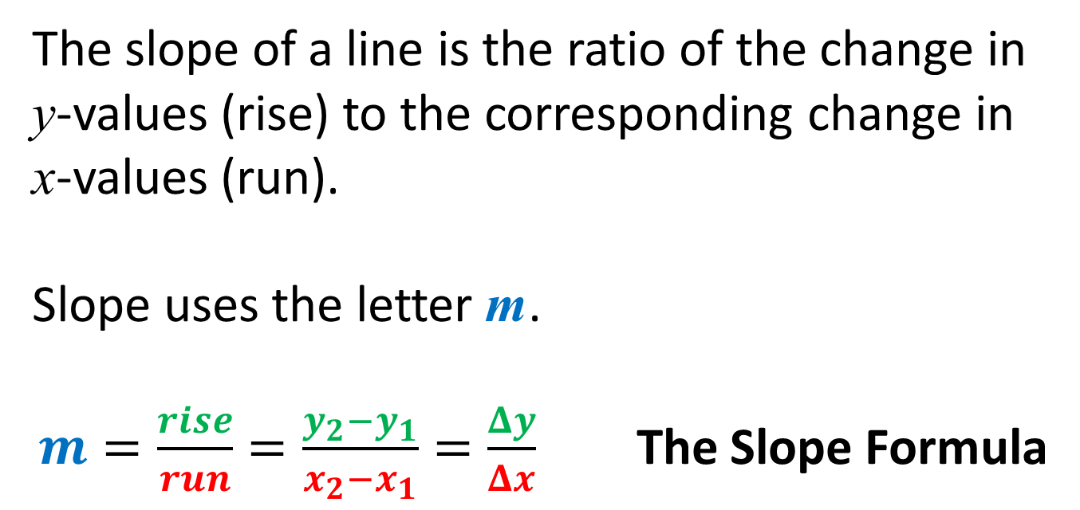
SLOPE
Slope (pendiente):
The slope of a line is the ratio of the change in
y-values (rise) to the corresponding change in
x-values (run).
Slope uses the letter m.
$m=\frac{rise}{run}=\frac{y_{2}−y_{1}}{x_{2}−x_{1}}=\frac{Δy}{Δx}$ The Slope Formula

Slide 6


Slide 7
KINDS of SLOPE
There are four kinds of slope.
  Positive slope
  Negative slope
  Zero Slope
  Undefined Slope (No Slope)

Slide 8
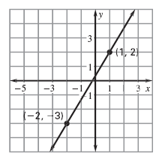
Positive Slope
Slope = Rise over Run
Positive slope goes uphill
These ratios are always positive.

Slide 9
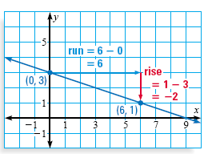
Negative Slope
Slope = Rise over Run
Negative slope goes downhill
These ratios are always negative.

Slide 10
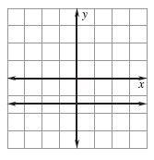
Zero Slope
Slope = Rise over Run
HORIZONTAL LINE.
These ratios always have
0 in the numerator
which is 0.

Slide 11
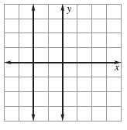
Undefined Slope (no slope)
Slope = Rise over Run
VERTICAL LINE
These ratios always have
0 in the denominator which is UNDEFINED.

Slide 12
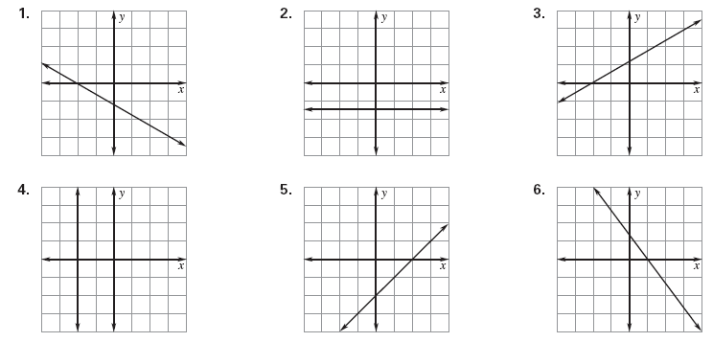
Slope Practice: Identify the type

