Slide 1
Analyzing Data Sets for One Variable
S.ID.1, 2, 3
http://www.cde.ca.gov/be/st/ss/documents/ ccssmathstandardaug2013.pdf

Slide 2
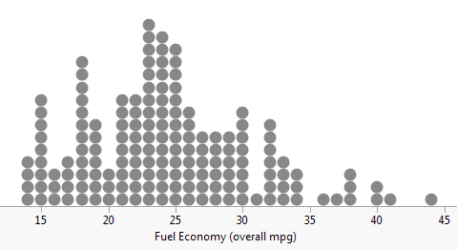
Curriculum Vocabulary
Discrete Data
Data that has only a finite number of values or data that can be “counted.”
Dot Plot
EXAMPLE:
A dot plot is a graph that shows how discrete data are graphed using a number line.

Slide 3
Curriculum Vocabulary
Data Distribution
The way in which data are spread out or clustered together.
Symmetric Distribution
In a symmetric distribution of data, the left and right halves of the graph are nearly mirror images of each other. There is often a “peak” in the middle of the graph.
EXAMPLE:

Slide 4
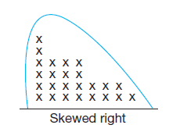
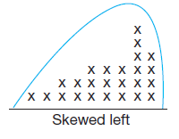
Curriculum Vocabulary
Skewed Right Distribution
In a skewed right distribution of data, the peak of the data is to the left side of the graph. There are only a few data points to the right side of the graph.
Skewed Left Distribution
In a skewed left distribution of data, the peak of the data is to the right side of the graph. There are only a few data points to the left side of the graph.

Slide 5
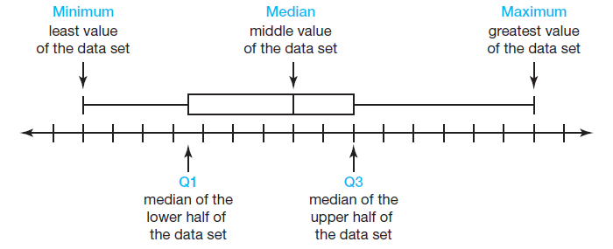
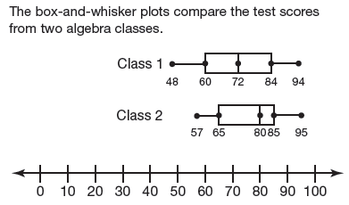
Curriculum Vocabulary
Five Number Survey
The five number survey consists of the minimum value, the first quartile (Q1), the median, the third quartile (Q3), and the maximum value of a data set.
Box-and-Whiskers Plot
A box-and-whiskers plot displays a data distribution based on a five number survey.

Slide 6
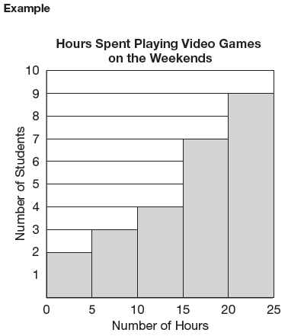
Curriculum Vocabulary
Histogram
A graphical way to display quantitative data using vertical bars.
Bin
The width of a bar in a histogram represents an interval of data and is often referred to as a bin.
Frequency
The height of each bar in a histogram indicates the frequency, which is the number of data values included in any given bin.

Slide 7
Curriculum Vocabulary
Continuous Data
Data which can take any numerical value within a range.
Statistic
Numerical characteristics of data.
Measure of Central Tendency
The numerical values used to describe the overall clustering of data in a set.
EXAMPLE:
MEAN, MEDIAN, and MODE are common measures of central tendency.

Slide 8
Curriculum Vocabulary
Interquartile Range (IQR)
The interquartile range, IQR, measures how far the data are spread out from the median
EXAMPLE:
In the data set 13, 17, 23, 24, 25, 29, 31, 45, 46, 53, 60, the median, 29, divides the data into two halves. The first quartile, 23, is the median of the lower half of the data. The third quartile, 46, is the median of the upper half of the data.
The interquartile range is 46 ─ 23, or 23.

Slide 9
Curriculum Vocabulary
Outlier
An outlier is a data value that is significantly greater or lesser than other data values in a data set.
EXAMPLE:
In the data set 1, 1, 3, 3, 4, 4, 5, 1000, the outlier is 1000.
Lower Fence
The value of $\text{Q}1−(\text{IQR}∙1.5)$is known as the lower fence for a data set.
Upper Fence
The value of $\text{Q}3+(\text{IQR}∙1.5)$is known as the upper fence for a data set.

Slide 10
Curriculum Vocabulary
Standard Deviation
Standard deviation is a measure of how spread out the data are from the mean. The formula that can be used to determine the standard deviation of a data set is
$$σ=\frac{\sqrt{\sum_{i=1}^{n}{{\left(x_{i}−\overline{x}\right)}^{2}}}}{n}$$
where:
$σ=$ standard deviation (lower case Greek letter sigma)
$\sum{=}$ sum of (upper case Greek letter sigma)
$x_{i}=$ each individual value in the data set
$\overline{x}=$ mean of all values in the data set
$n=$ number of data points in the set

Slide 11
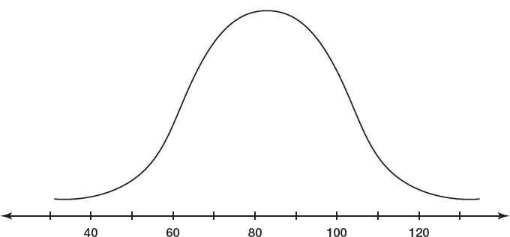
Curriculum Vocabulary
Normal Distribution
A normal distribution is a collection of many data points that form a bell-shaped curve.
EXAMPLE:

Slide 12
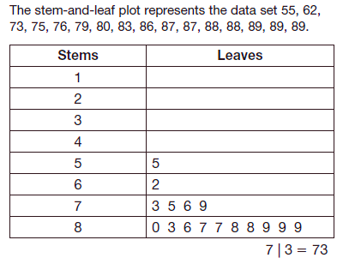
Curriculum Vocabulary
Stem-and-Leaf Plot
A graphical method used to represent ordered numerical data.
EXAMPLE:

Slide 13
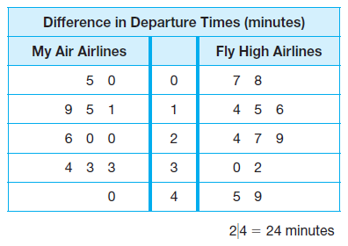
Curriculum Vocabulary
Side-by-Side Stem-and Leaf Plot
A side-by-side stem-and-leaf plot allows a comparison of two data sets. The two data sets share the same stem, but have leaves to the left and right of the stem.
EXAMPLE:

