Slide 1
Exponential Functions
A.SSE.1.a,b
A.CED.1, 2
A.REI.3, 10, 11
F.LE.1, 2, 3, 5
F.BF.1, 2, 3
F.IF.3, 4, 6, 7
N.RN.1, 2
N.Q.2
http://www.cde.ca.gov/be/st/ss/documents/ ccssmathstandardaug2013.pdf

Slide 2
Building Formulas
Let’s compare two very real world financial situations.
SIMPLE INTEREST
-vs-
COMPOUND INTEREST

Slide 3
Simple Interest
In a SIMPLE INTEREST account, the interest earned at the end of each year is a percent of the original deposited amount (principal).
If Jack deposits $1000 into an account that earns 5% simple interest each year, write the first 6 terms of the sequence representing the first 5 years of Jack’s investment.
1000, 1050, 1100, 1150, 1200, 1250

Slide 4
Complete the table below:

Slide 5
Simple Interest
1000, 1050, 1100, 1150, 1200, 1250
What kind of sequence did you conclude this would be?
ARITHMETIC
What is the common difference?
$$d=0.05(1000)$$
What was that?
The interest rate times the principal $= P_{0}r$

Slide 6
Simple Interest
1000, 1050, 1100, 1150, 1200, 1250
What is the first term in the sequence?
1000
How would you write an explicit formula for an arithmetic sequence? (Use P for amount and r for the rate)
$$P_{n}=P_{1}+P_{0}r\left(n−1\right)$$

Slide 7
Simple Interest
$$P_{n}=P_{1}+P_{0}r\left(n−1\right)$$
Now rewrite the equation as a function with $n=t$, where t represents the time in years:
STATEMENT | REASON
$$P_{t}=P_{1}+P_{0}r\left(t−1\right)$$
Explicit Formula for Arithmetic Sequence
$$P\left(t\right)=P_{1}+P_{0}r\left(t−1\right)$$
Represent $P_{t}$ using function notation
$$P\left(t\right)=P_{1}+P_{0}rt−P_{0}r$$
Distributive Property
$$P\left(t\right)=P_{0}rt+P_{1}−P_{o}r$$
Commutative Property
$$P\left(t\right)=P_{0}rt+\left(P_{0}+P_{0}r\right)−P_{o}r$$
Since $P_{1}=P_{0}+P_{0}r$
$$P\left(t\right)=P_{0}rt+P_{o}$$
Combine Like Terms
So the formula for simple interest is
$$P\left(t\right)=P_{0}rt+P_{o}$$
where t is the number of years and $P_{o}$ is the principal

Slide 8
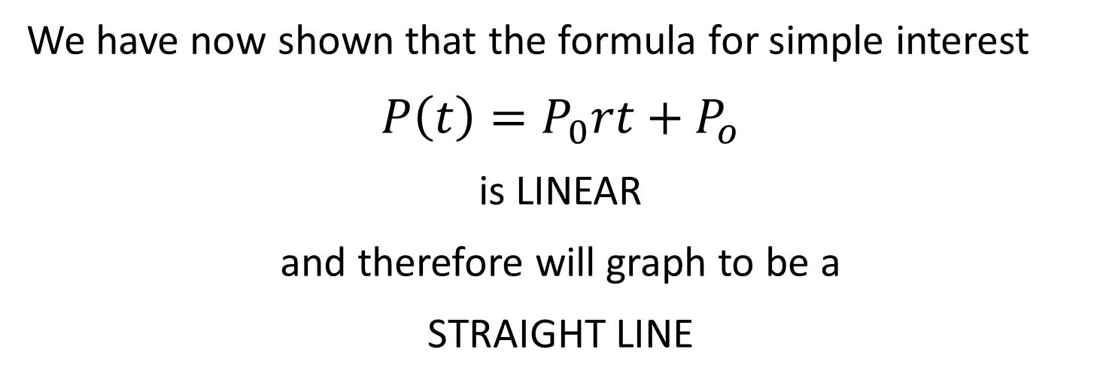
Simple Interest
We have now shown that the formula for simple interest
$$P\left(t\right)=P_{0}rt+P_{o}$$
is LINEAR
and therefore will graph to be a
STRAIGHT LINE

Slide 9
Compound Interest
In a COMPOUND INTEREST account, the interest earned at the end of each year is a percent of the account balance at the beginning of the year.
If Jill deposits $1000 into an account that earns 5% compound interest each year, write the first 6 terms of the sequence representing the first 5 years of Jill’s investment.
1000, 1050, 1102.5, 1157.625, 1215.50625, 1276.281563

Slide 10
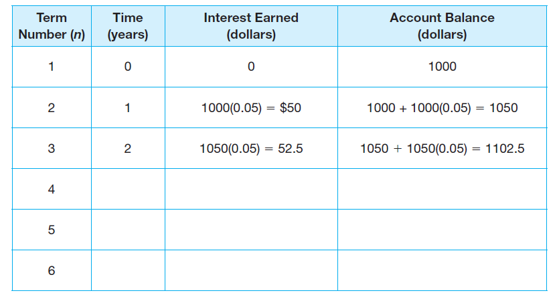
Complete the table below:

Slide 11
Compound Interest
1000, 1050, 1102.5, 1157.625, 1215.50625, 1276.281563
What kind of sequence did you conclude this would be?
GEOMETRIC
What is the common ratio?
$$1+0.05$$
What was that?
The interest rate + the previous year $=\left(1+r\right)$ where $r$ is the interest rate in the account

Slide 12
Compound Interest
1000, 1050, 1102.5, 1157.625, 1215.50625, 1276.281563
What is the first term in the sequence?
1000
How would you write an explicit formula for a geometric sequence? (Use P for amount and r for the rate)
$$P_{n}=P_{1}∙{\left(1+r\right)}^{n−1}$$

Slide 13
Compound Interest: $P_{n}=P_{1}∙{\left(1+r\right)}^{n−1}$
Now rewrite the equation as a function with $n=t$, where t represents the time in years:
STATEMENT | REASON
$$P_{t}=P_{1}∙{\left(1+r\right)}^{t−1}$$
Explicit Formula for Geometric Sequence
$$P\left(t\right)=P_{1}∙{\left(1+r\right)}^{t−1}$$
Represent $P_{t}$ using function notation
$$P\left(t\right)=P_{1}∙{\left(1+r\right)}^{t}∙{\left(1+r\right)}^{−1}$$
Product Rule of Exponents
$$P\left(t\right)=P_{1}∙{\left(1+r\right)}^{−1}∙{\left(1+r\right)}^{t}$$
Commutative Property
$$P\left(t\right)=P_{1}∙\frac{1}{1+r}∙{\left(1+r\right)}^{t}$$
Definition of Negative Exponent
$$P\left(t\right)=\frac{P_{0}+P_{0}r}{1+r}∙{\left(1+r\right)}^{t}$$
Since $P_{1}=P_{0}+P_{0}∙r$ and Multiply
$$P\left(t\right)=\frac{P_{0}\left(1+r\right)}{\left(1+r\right)}∙{\left(1+r\right)}^{t}$$
Factoring
$$P\left(t\right)=P_{0}∙{\left(1+r\right)}^{t}$$
Simplify

Slide 14
Compound Interest
We have now shown that the formula for compound interest is
$$P\left(t\right)=P_{0}∙{\left(1+r\right)}^{t}$$
is EXPONENTIAL
and therefore will graph to be an
ASYMPTOTIC FUNCTION

Slide 15
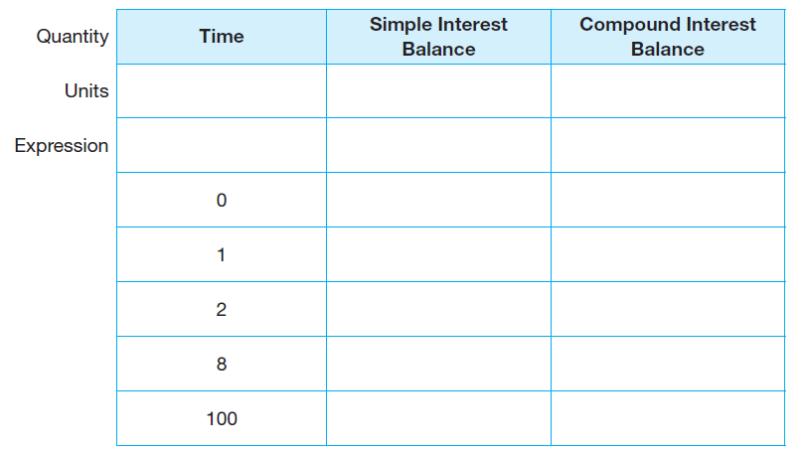
Use the information from the tables you created for Jack & Jill to complete the table below:

Slide 16
Hillary is looking for some financial advice. She has the option to deposit $1000 into the simple interest account, just like Jack’s account; or a compound interest account, just like Jill’s account. The compound interest account has a one-time start up fee of $200, while the simple interest account is free. Into which account would you recommend Hillary deposit her money and why?
Now use DESMOS to graph both equations for Simple Interest and Compound Interest on the SAME GRAPH.

