Slide 1
Exponential Functions
A.SSE.1.a,b
A.CED.1, 2
A.REI.3, 10, 11
F.LE.1, 2, 3, 5
F.BF.1, 2, 3
F.IF.3, 4, 6, 7
N.RN.1, 2
N.Q.2
http://www.cde.ca.gov/be/st/ss/documents/ ccssmathstandardaug2013.pdf

Slide 2
Vertical Translations
Let’s compare some linear functions:
$g\left(x\right)=x$
$c\left(x\right)=\left(x\right)+3$
$d\left(x\right)=\left(x\right)−3$
The first function is the BASIC FUNCTION. A BASIC FUNCTION is the simplest function of its type.
All linear functions can be written in terms of the basic linear function $g(x)$.

Slide 3
Vertical Translations
Example:
$$c\left(x\right)=\left(x\right)+3$$
Since $g\left(x\right)=x$:
$$c\left(x\right)=\left(x\right)+3$$
$$c\left(x\right)=g\left(x\right)+3$$
Rewrite $d(x)$ in terms of the basic function $g(x)$:
Describe the operation performed on the basic function $g(x)$.

Slide 4
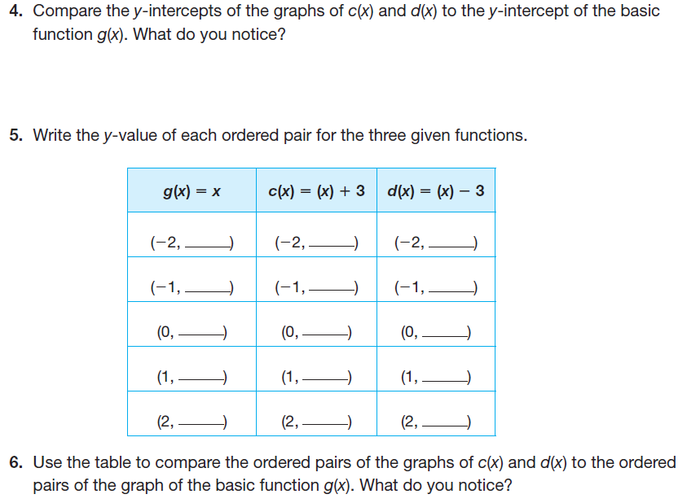
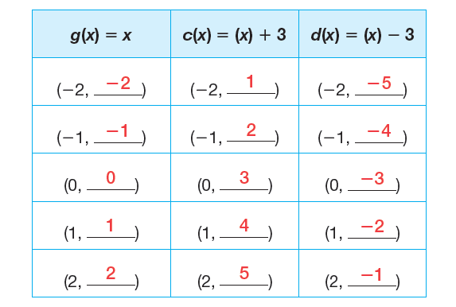
Vertical Translations
Use DESMOS to complete number 3 on Page 314.
Then answer questions 4 – 6 on Page 315

Slide 5
Vertical Translations
A TRANSFORMATION is the mapping, or movement, of all points of a figure in a plane according to a common operation.
A VERTICAL TRANSLATION is a type of transformation that shifts the entire graph up or down. A vertical translation affects the y-coordinate of each point on the graph.
COORDINATE NOTATION is a notation that uses ordered pairs to describe a transformation in a coordinate plane.
$$\left(x,y\right)\underset{→}{}\left(x,y+b\right), \text{where} b \text{is} \text{a} \text{real} \text{number}.$$

Slide 6
Vertical Translations
Use coordinate notation to represent the vertical translation of each function:
$g\left(x\right)=x$
$(x,y)$
$c\left(x\right)=\left(x\right)+3$
$(x,y)\underset{→}{}$
$d\left(x\right)=\left(x\right)−3$
$(x,y)\underset{→}{}$

Slide 7
Vertical Translations
Now let’s consider the following three exponential functions:
$h\left(x\right)=2^{x}$
$s\left(x\right)=\left(2^{x}\right)+3$
$t\left(x\right)=\left(2^{x}\right)−3$
In this case $h\left(x\right)=2^{x}$is the BASIC FUNCTION because it is the simplest function with a base of 2.
Write the functions $s(x)$ and $t(x)$ in terms of the basic function $h(x)$.
$s(x)=$
$t(x)=$

Slide 8
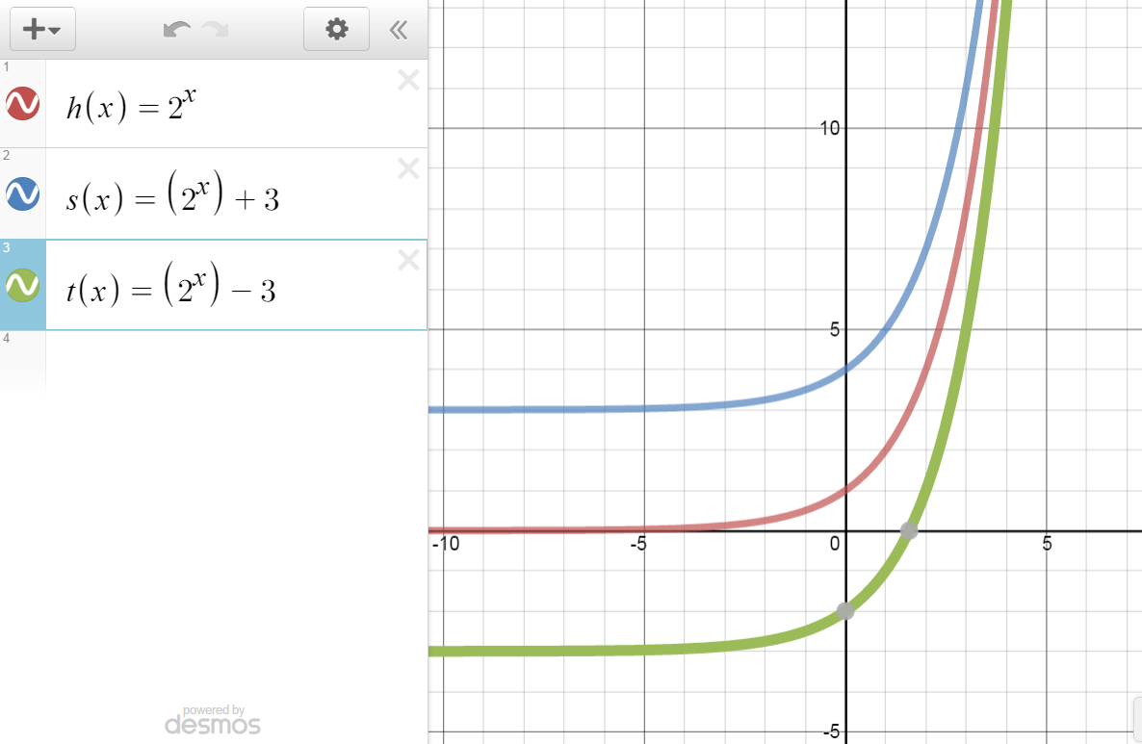
Use DESMOS to complete number 9 on Page 316.
Then answer questions 10 – 14 on Pages 316 - 317

Slide 9
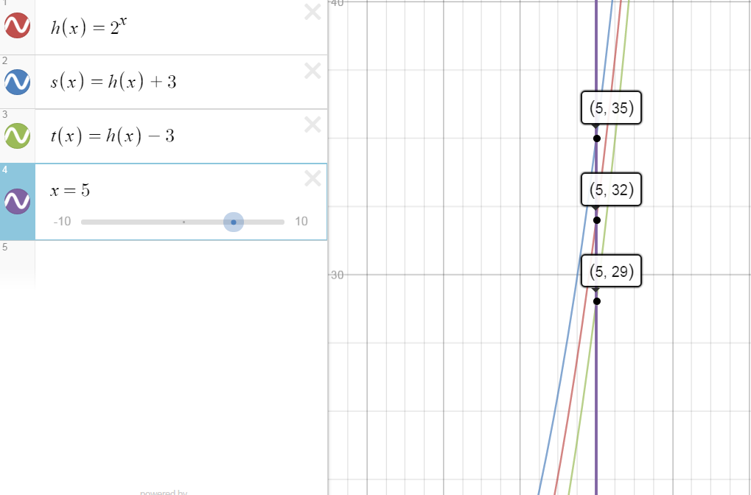

Slide 10
Vertical Translations

Slide 11
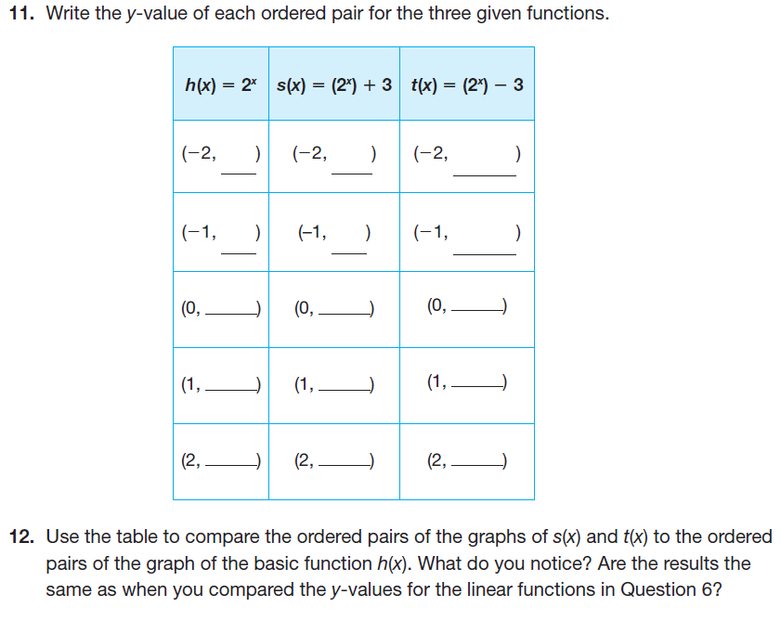
Vertical Translations

Slide 12
Vertical Translations

Slide 13
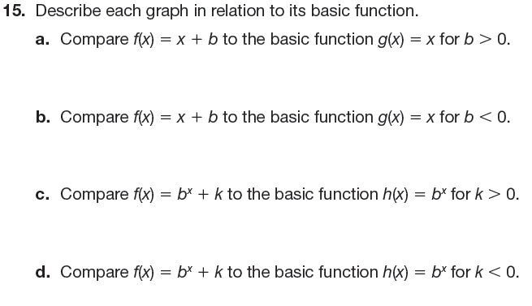
Vertical Translations
Now complete 15 – 17 on Page 318:

Slide 14
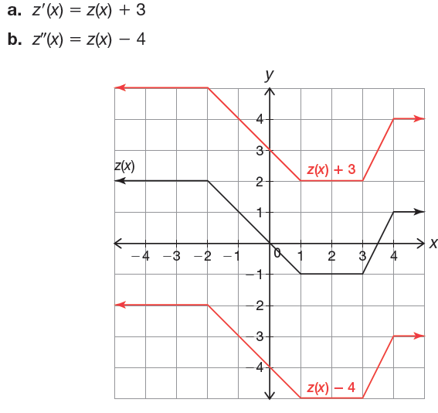
Vertical Translations

Slide 15
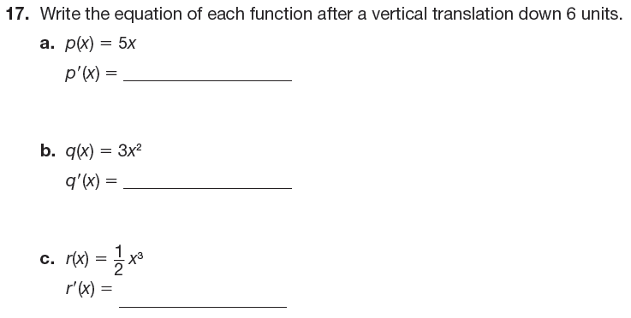
Vertical Translations

Slide 16
Horizontal Translations
In HORIZONTAL TRANSLATIONS the operations are performed on $x$, which is the ARGUMENT OF THE FUNCTION.
The ARGUMENT OF THE FUNCTION is the variable on which the function operates.
In most cases the argument of a function is either $x$or $t$(for time). With a HORIZONTAL TRANSLATION the argument changes.

Slide 17
Horizontal Translations
Consider the following exponential functions:
$h\left(x\right)=2^{x}$
$v\left(x\right)=2^{(x+3)}$
$w\left(x\right)=2^{(x−3)}$
How would you write $v(x)$ in terms of $h(x)$?
$$v\left(x\right)=h\left(x+3\right)=2^{(x+3)}$$
Notice that the argument changes!

Slide 18
Horizontal Translations
Now complete questions 1 – 3 on Page 319.
Use DESMOS to graph each of the following functions:
$h\left(x\right)=2^{x}$
$v\left(x\right)=2^{(x+3)}$
$w\left(x\right)=2^{(x−3)}$

Slide 19
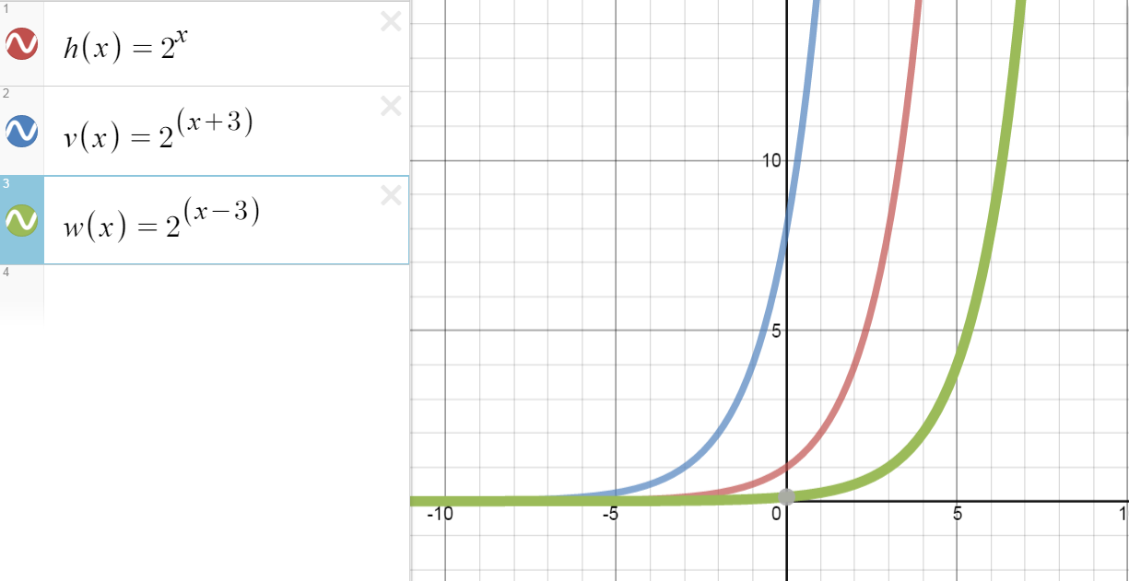
Compare the graphs of 𝑣(𝑥) and 𝑤(𝑥) to the graph of the basic function. What do you notice?

Slide 20
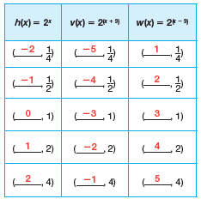
Horizontal Translations
Now complete questions 4 & 5 on page 320:

Slide 21
Horizontal Translations
A HORIZONTAL TRANSLATION of a graph shifts the entire graph left or right. A horizontal translation affects the x-coordinate of each point on the graph.
The coordinate notation that used to describe a horizontal transformation in a coordinate plane.
$$\left(x,y\right)\underset{→}{}\left(x+a,y\right), \text{where} a \text{is} \text{a} \text{real} \text{number}.$$
To shift a function left, add inside the function's argument:
$f(x+b)$ gives $f(x)$ shifted $b$ units to the left.
Shifting to the right works the same way:
$f(x−b)$ is $f(x)$shifted $b$ units to the right.

Slide 22
Translations of Functions

Slide 23
Horizontal Translations
WARNING:
The common temptation is to think that $f(x +3)$ moves $f(x)$ to the right by three, because "$+3$" is to the right.
But the left-right shifting is backwards from what you might have expected.
Adding moves you left; subtracting moves you right.
If you lose track, think about the point on the graph where $x = 0$. For$f(x + 3)$, what does x now need to be for $0$ to be plugged into $f$?
In this case, $x$ needs to be$–3$, so the argument is $–3 + 3 = 0$, so you need to shift left by three. This process will tell you where the x-values, and thus the graph, have shifted.

Slide 24
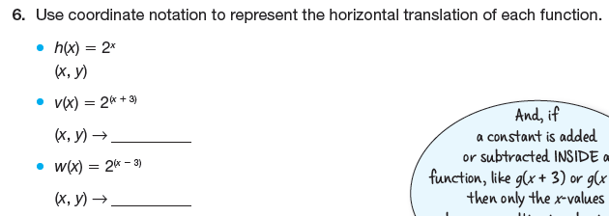
Horizontal Translations
Now complete 6 – 9 on Pages 320 – 321:

Slide 25
Horizontal Translations

Slide 26
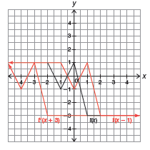
Horizontal Translations

Slide 27
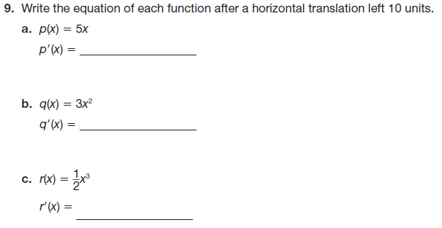
Horizontal Translations

Slide 28
Linear Functions
Now consider the following three linear functions:
$$g\left(x\right)=x$$
$$j\left(x\right)=g\left(x\right)+5$$
$$k\left(x\right)=g\left(x+5\right)$$
Complete PROBLEM 3 on Page 322 with your group. Be ready to share your findings with the class.

Slide 31
