Slide 1
Parallel Lines Cut by a Transversal
Essential Question?
What can you conclude about the angles formed by parallel lines that are cut by a transversal?
8.G.5

Slide 2
Common Core Standard:
8.G ─Understand congruence and similarity using physical models, transparencies, or geometry software.
5. Use informal arguments to establish facts about the angle sum and exterior angle of triangles, about the angles created when parallel lines are cut by a transversal, and the angle-angle criterion for similarity of triangles. For example, arrange three copies of the same triangle so that the sum of the three angles appears to form a line, and give an argument in terms of transversals why this is so.

Slide 3
Objectives:
To describe the relationships about angles formed by parallel lines that are cut by a transversal.

Slide 4
Curriculum Vocabulary
Angle (ángulo):
A figure formed by two rays with a common endpoint called the vertex.
Acute Angle (ángulo agudo):
An angle that measures greater than 0˚ and less than 90˚.
Obtuse Angle (ángulo obtuso):
An angle that measures greater than 90˚ and less than 180˚.
Parallel Lines (lineas paralelas):
Lines in a plane that do not intersect.
Adjacent Angles (ángulos adycentes):
Angles in the same plane that have a common vertex and a common side, but no common interior points

Slide 5
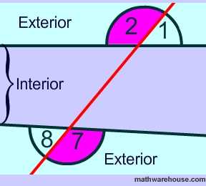
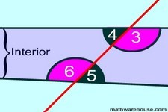
Curriculum Vocabulary
Transversal (transversal):
A line that intersects two or more lines.
Alternate Exterior Angles (ángulos alternos externos):
For two lines intersected by a transversal, a pair of nonadjacent angles that lie on opposite sides of the transversal and outside the other two lines.
Alternate Interior Angles (ángulos alternos internos):
For two lines intersected by a transversal, a pair of nonadjacent angles that lie on opposite sides of the transversal and between the other two lines.

Slide 6
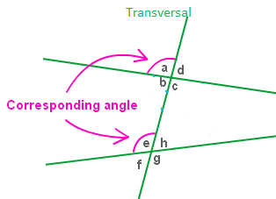
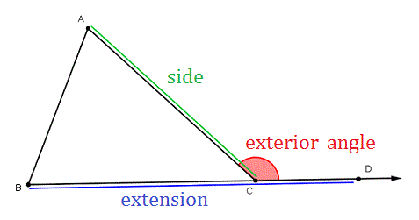
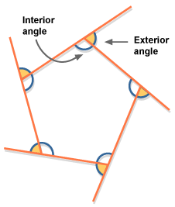
Curriculum Vocabulary
Corresponding Angles (ángulos correspondientes):
For two lines intersected by a transversal, a pair of angles that lie on same side of the transversal and on the same sides of the other two lines.
Exterior Angle (ángulo externo de un polígono):
An angle formed by one side of a polygon and the extension of an adjacent side
Interior Angles (ángulos internos):
Angles on the inner sides of two lines cut by a transversal.
The angles inside of a polygon.

Slide 7
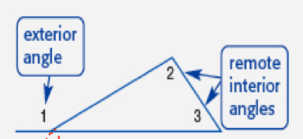
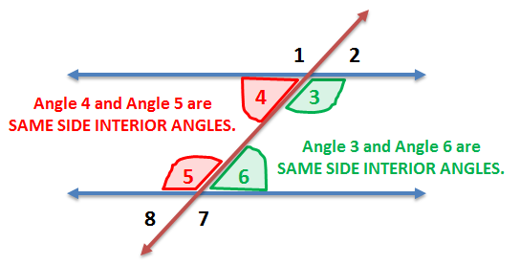
Curriculum Vocabulary
Remote Interior Angle (ángulo interno remoto):
An interior angle of a polygon that is not adjacent to the exterior angle.
Same-Side Interior Angles (ángulos internos del mismo lado):
A pair of angles on the same side of a transversal and between two lines intersected by the transversal.

Slide 8
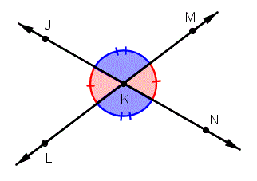
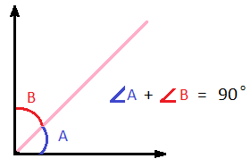
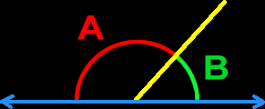
Curriculum Vocabulary
Vertical Angles (ángulo opuestos por el vértice):
A pair of non-adjacent angles formed by intersecting lines.
Complementary Angles (ángulos complementarios):
Two angles whose measures add to 90°.
Supplementary Angles (ángulos suplementarios):
Two angles whose measures add to 180°.
$$∠A+∠B=180°$$

Slide 9
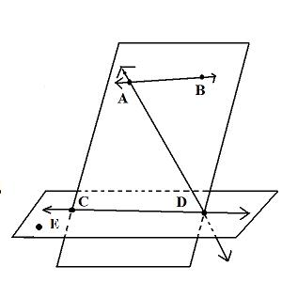
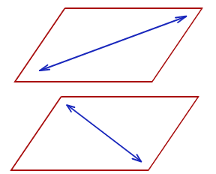
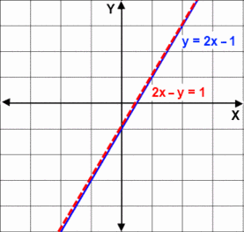
Curriculum Vocabulary
Coplanar Lines (líneas coplanares):
Lines that lie in the same plane
Skew Lines (líneas distorsionadas):
Lines that do not lie in the same plane.
Coincidental Lines (líneas coincidentes):
Lines that have equivalent linear equations and overlap at every point when they are graphed.

Slide 10
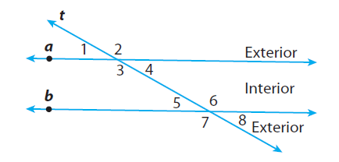
Parallel Lines & Transversals
A TRANSVERSAL is a line that intersects two lines in the same plane at different points.
In this example, transversal t and lines a and b form eight angles.
Angle Pairs Formed by a Transversal
Term | Example
Corresponding Angles lie on the same side of the transversal t, on the same side of lines a and b.
$$∠1 \text{and} ∠5$$
Alternate Interior Angles are nonadjacent angles that lie on opposite sides of the transversal t, between lines a and b.
$∠3 \text{and} ∠$6
Alternate Exterior Angles lie on opposite sides of the transversal t, outside lines a and b.
$∠1 \text{and} ∠$8
Same-side Interior Angles lie on the same side of the transversal t, between lines a and b.
$$∠3 \text{and} ∠5$$

Slide 11
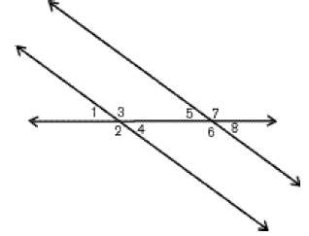
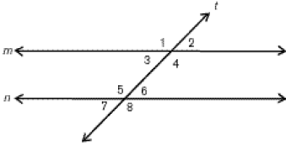
Parallel Lines & Transversals
When a TRANSVERSAL intersects two lines that are PARALLEL, the angles have special relationships.
You can tell from a diagram if two lines are PARALLEL, by the presence of the symbols   shown on the line.







Slide 12
Parallel Lines & Transversals
The symbol for PARALLEL is
∥
The symbol for NOT PARALLEL is
∦

Slide 13
Parallel Lines & Transversals
The symbol for PERPENDICULAR is
⏊
The symbol for NOT PERPENDICULAR is
⏊

Slide 14
Now let’s complete the worksheet.
Use a protractor to measure each of the angles listed in the table:
Angle | Measure
∠1
∠2
∠3
∠4
∠5
∠6
∠7
∠8

Slide 15
Which angles are congruent?
Now fill out the following tables based on the measurements you took:
ANGLE TYPE | ANGLE PAIRS
CORRESPONDING
Alternate Interior
Alternate Exterior
SAME-SIDE Interior

Slide 16
WITHOUT using a protractor give the measure of all the angles listed in the table:
Angle | Measure
∠A | 60˚
∠B
∠C
∠D
∠E
∠F
∠G
∠H
<
<

Slide 17
How did you find the measure of ∠B?
How did you find the measure of ∠C?
Now fill out the following tables based on the information above:
ANGLE TYPE | ANGLE PAIRS
CORRESPONDING
Alternate Interior
Alternate Exterior
SAME-SIDE Interior

Slide 18
Parallel Lines & Transversals
What observations did you make and what conclusions can you draw when a TRANSVERSAL intersects two lines that are PARALLEL?
CORRESPONDING ANGLES are
Alternate Interior ANGLES are
Alternate Exterior ANGLES are
VERTICAL ANGLES are
SAME-SIDE Interior ANGLES are
ADJACENT ANGLES are
CONGRUENT
CONGRUENT
CONGRUENT
CONGRUENT
SUPPLEMENTARY
SUPPLEMENTARY

Slide 19
<
<

