Slide 1
Representing Functions
F-IF: 1, 2, 5, 7, 9
A-REI: 10

Slide 2
Types of Functions
Increasing Function
As the independent variable increases, the dependent variable also increases across the entire domain.
Decreasing Function
As the independent variable increases, the dependent variable decreases across the entire domain.
Constant Function
As the independent variable increases, the dependent variable does not change (stays the same) across the entire domain.

Slide 3
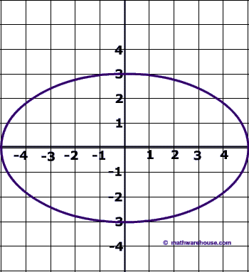
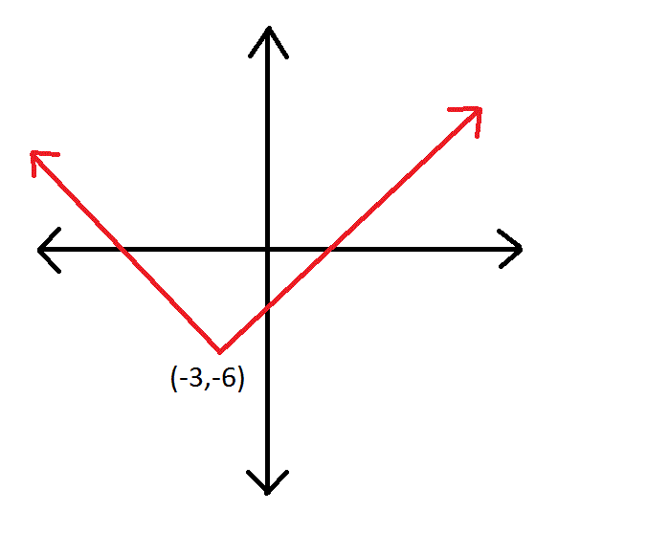
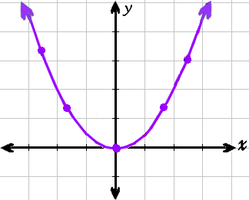
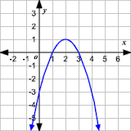
Attributes
Absolute Minimum
If there is a point that has a y-coordinate that is less than the y-coordinate of every other point, the function has an absolute minimum.
Absolute Maximum
If there is a point that has a y-coordinate that is greater than the y-coordinate of every other point, the function has an absolute maximum.
?
Not a Function

Slide 4
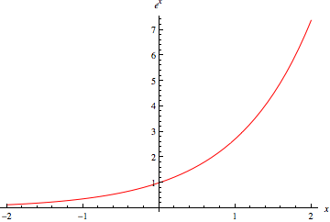
Exponential Functions
Why don’t exponential functions have a maximum or minimum?

Slide 5
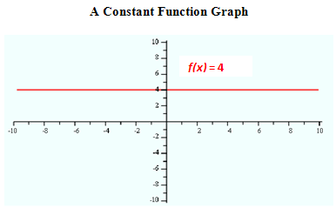
Constant Functions
What about constant functions?
Do they have a maximum / minimum?

Slide 6
Function Families
Function Family
A function family is a group of functions that share certain characteristics.
Linear Functions
Functions of the form f(x) = mx + b, where m and b are real numbers. They graph to be a line.
Exponential Functions
Functions of the form f(x) = a∙b^{x} + c, where a, b, and c are real numbers, and b is greater than 0 but is not equal to 1. Their graphs are called asymptotic.

Slide 7
Function Families
Quadratic Functions
Functions of the form f(x)= ax² + bx + c, where a, b, and c are real numbers, and a ≠0. They graph to be a parabola.
Linear Absolute Value Functions
Functions of the form f(x) = a ⎸x + b⎹ + c, where a, b, and c are real numbers and a ≠ 0. Their graphs are made up of straight lines and look like V or Λ.
Linear Piecewise Functions
Functions that have equation changes for different parts, or pieces, of the domain. Their graphs appear to be made up of a collection of lines and/or line segments.

