Slide 1
Graphically Representing Data

Slide 2
Objectives:
To represent and interpret data displayed on dot plots
To represent and interpret data displayed on histograms
To represent and interpret data displayed on box-and-whisker plots

Slide 3
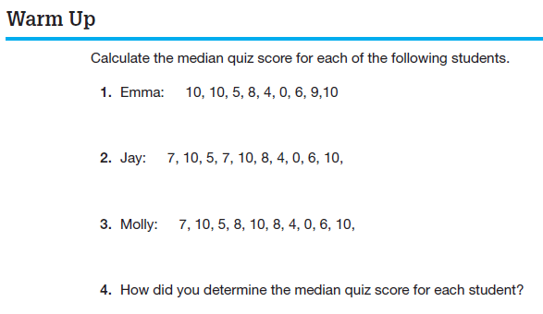

Slide 4
Let’s read PROBLEM 1 on Page 456:
Now answer Question 1 on the top of page 457:
Analyze the data collected. What conclusions can you draw about the sugar amount in different types of cereal?

Slide 5
How might you arrange the data to better organize it?
A DOT PLOT is a graph that shows how discrete data are distributed using a number line.
DISCRETE DATA are data that has only a finite number of values or data that can be “counted.”
Dot plots are best used to organize and display the number of occurrences of a small number of data points.
Now answer Question 2 in the middle of page 457:
Construct a dot plot to represent the sugar amount in one serving of each breakfast cereal. Label the number line using intervals that will include all the data values. Place an “x” above the number that represents each data value. Make sure you name your dot plot.

Slide 6
Now answer Question 3 on page 457:
Analyze the dot plot. What conclusions can you draw about the sugar amounts in one serving of breakfast cereal from the dot plot?

Slide 7
Complete PROBLEM 4 on Page 458:
Jordan states that those numbers on the number line that do not contain any data values should be eliminated. Toni disagrees and says that all the numbers on the number line must be included even if there are no data values for that particular number.
Who is correct? Explain your reasoning.
When you analyze a graphical display, you can look at several characteristics of the graph to draw conclusions. For example, you can ask yourself:
What is the overall shape of the graph? Does it have any interesting patterns?
Where is the approximate middle, or center, of the graph?
How spread out are the data values on the graph?

Slide 8
The overall shape of a graph is called the data distribution.
The DATA DISTRIBUTION is the way in which the data is spread out or clustered together. The shape of the distribution can reveal a lot of information about the data. There are many different distributions, but the most common are symmetric, skewed right, and skewed left as shown.

Slide 9
Complete PROBLEM 5 on Page 459:
5. Describe the properties of a data distribution that is:
symmetric
skewed right
skewed left

Slide 10
In a symmetric distribution of data, the left and right halves of the graph are nearly mirror images of each other. There is often a “peak” in the middle of the graph.
In a skewed right distribution of data, the peak of the data is to the left side of the graph. There are only a few data points to the right side of the graph.
In a skewed left distribution of data, the peak of the data is to the right side of the graph. There are only a few data points to the left side of the graph.

Slide 11
Now complete PROBLEMS 6 and 7 on Page 459:
6. Describe the distribution of the sugar amount in one serving of breakfast cereal. Explain what this means in terms of the problem situation.
7. Do you think the conclusion you came to in Question 6 is true of all breakfast cereals? Why or why not?

Slide 12
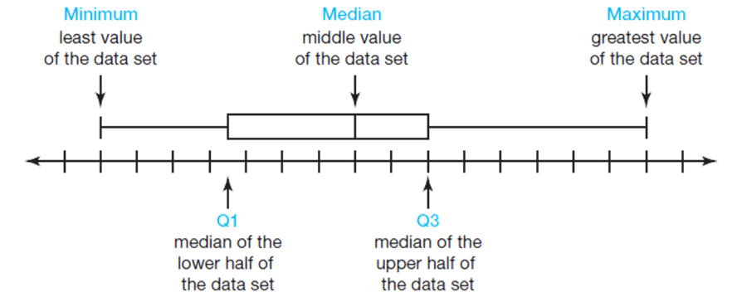
Another graphical representation that displays the distribution of quantitative data (numerical data) is a box-and-whisker plot.
A BOX-and-WHISKER PLOT displays the data distribution based on a five number summary. The five number summary consists of the minimum value, the first quartile (Q1), the median, the third quartile (Q3), and the maximum value.
The five number summary is used to create a box-and-whisker plot. Each vertical line of the box-and-whisker plot represents a value from the summary.

Slide 13
There are four sections of the graphical display:
minimum to Q1, Q1 to median, median to Q3, and Q3 to maximum.
Each section of the box-and-whisker plot represents 25 percent of the data set.

Slide 14
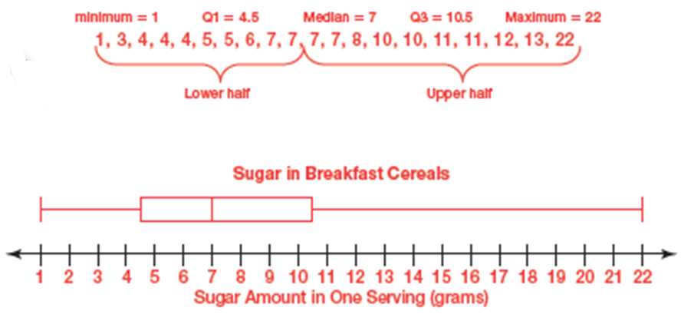
Complete PROBLEM 2 on Page 462:
2. Construct a box-and-whisker plot of the sugar amount in one serving of each breakfast cereal from Problem 1, How Much Sugar Is Too Much?

Slide 15
Complete PROBLEMS 3 and 4 on Page 462:
3. Analyze the five number summary and box-and-whisker plot. What conclusions can you draw about the sugar amount in one serving of breakfast cereal from these representations?
4. Describe the data distribution shown in the box-and-whisker plot. Interpret the meaning of the distribution in terms of this problem situation.

Slide 16
Now complete PROBLEM 5 on Page 463:
5. Damon states that more breakfast cereals have over 10 grams of sugar per serving than have under 5 grams of sugar per serving because the whisker connecting the maximum and Q3 is longer than the whisker connecting the minimum and Q1.
Is Damon correct? Explain why or why not.

Slide 17
Another way to display quantitative data is to create a histogram. A HISTOGRAM is a graphical way to display quantitative data using vertical bars.
The width of a bar in a histogram represents an interval of data and is often referred to as a bin. A BIN is represented by intervals of data instead of showing individual data values. The value shown on the left side of the bin is the least data value in the interval.
The height of each bar indicates the FREQUENCY, which is the number of data values included in any given bin.
Histograms are effective in displaying large amounts of continuous data. CONTINUOUS DATA is data which can take any numerical value within a range.

Slide 18
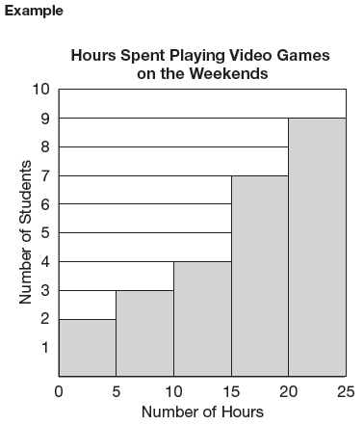
This histogram represents the data distribution for the number of hours students spend playing video games on the weekends. The data is gathered to the nearest half-hour.
What conclusions can you draw from the histogram about the number of hours students spend playing video games on weekends?

Slide 19
Complete PROBLEM 2 on Page 464:
2. Jonae and Tyler must identify the greatest value represented in the bin beginning with 15. Their responses are shown.
Explain why Tyler’s answer is correct and why Jonae’s answer is incorrect.
b. Represent the bin that contains 15 as an inequality.
 Jonae
The bin that begins with the interval 15 includes all data values from 15 to 20.
 Tyler
The bin that begins with the interval 15 includes all data values from 15 thru, but not including 20.

Slide 20
Now complete PROBLEMs 3 and 4 on Pages 464 and 465:
3. Analyze the histogram.
How many students play 5 to 9.5 hours of video games on weekends? Explain your reasoning.
b. How many total students are included in the data? Explain your reasoning.
c. Marcel states that between 0 and 5 students spend 2 hours playing video games on weekends. Is Marcel’s statement correct? Explain why or why not.

Slide 21
d. How many students play 22 hours of video games on the weekends? Explain your reasoning.
e. What percent of the students play 10 or more hours of video games on the weekends? Explain your reasoning.
4. Describe the data distribution displayed by the histogram. Interpret its meaning in terms of this problem situation.

Slide 22
Homework:
Complete Talk the Talk, pages 466 – 468.

