Slide 1
Finding Rate of Change from a Graph

Slide 2
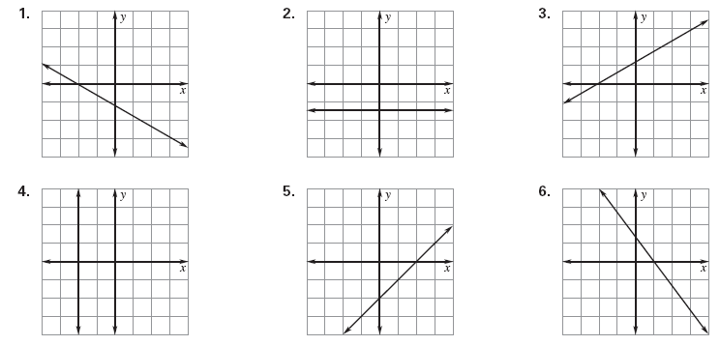
Slope Practice: Identify the type

Slide 3
How to Find Slope from a Graph
y
Step 1: Determine the TYPE of SLOPE
Step 2: Determine two points on the graph
Step 3: Shade a rectangle
Step 4: COUNT the rise & run
Step 5: Create the fraction $m=\frac{rise}{run}$
Don’t forget the SIGN
Step 6: SIMPLIFY the fraction (if necessary)
x

Slide 4
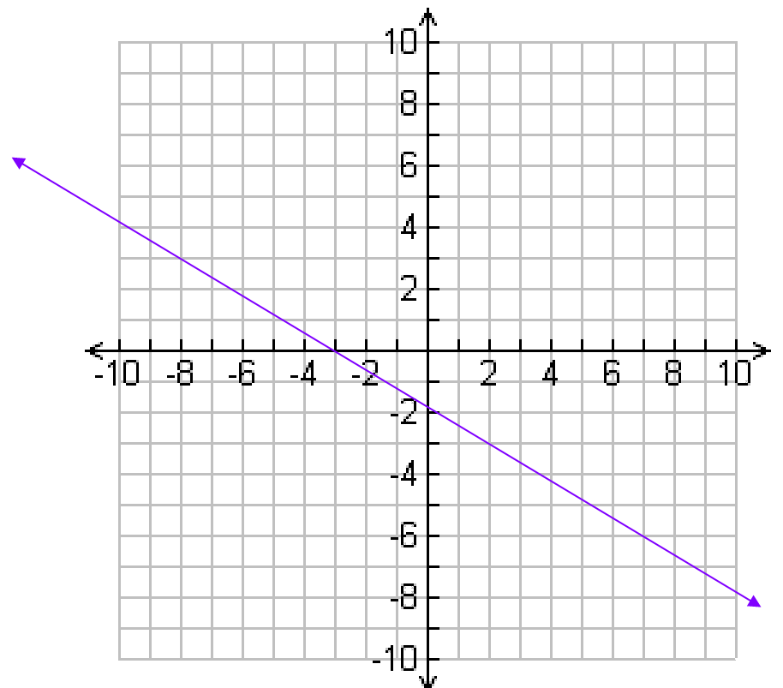
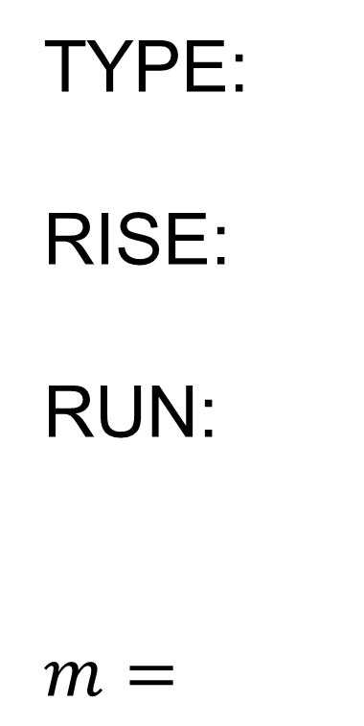
Determine the Slope
TYPE:
RISE:
RUN:
$$m=$$

Slide 5
SLOPE
The slope of a line remains CONSTANT between any two points on the line!!!

Slide 6
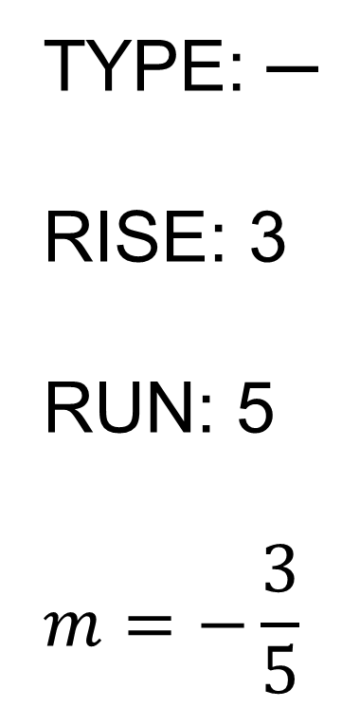
What is the Slope between the two red points?
TYPE: ─
RISE: 3
RUN: 5
$$m=−\frac{3}{5}$$

Slide 7
What is the Slope between the two red points?
TYPE: ─
RISE: 3
RUN: 5
$$m=−\frac{3}{5}$$

Slide 8
What is the Slope between the two red points?
TYPE: ─
RISE: 3
RUN: 5
$$m=−\frac{3}{5}$$

Slide 9
Slope from a Graph
Slope -
The rate of change that determines the
direction of a line and how steep it is.
y
vertical change
Slope =
horizontal change
+2
+3
-6
rise
Slope =
x
run
+3
3
-4
Slope =
m
=
=
+2
2
-6
3
m =
=
-4
2

Slide 10
Find the slope of the line below.
y
rise
Slope =
run
+1
Slope =
+4
+4
x
1
+1
m =
-2
4
-8
-2
1
m =
=
-8
4

Slide 11
Find the slope of the line below.
y
rise
Slope =
+1
run
+3
Slope =
+3
+1
x
m = 3

Slide 12
Find the slope of the line below.
y
+4
rise
Slope =
+3
run
+3
Slope =
+4
x
3
m =
4

Slide 13
Find the slope of the line below.
y
rise
Slope =
-1
run
+2
-1
Slope =
+2
x
1
m =
2

Slide 14
Find the slope of the line below.
y
rise
Slope =
run
-2
-2
Slope =
+3
+3
x
2
m =
3

Slide 15
Find the slope of the line below.
y
rise
Slope =
run
-2
Slope =
+1
x
m = -2
-2
+1

Slide 16
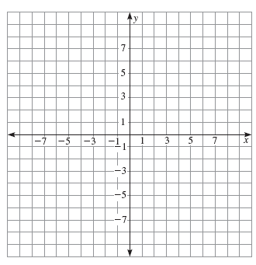
Identify from a graph
Identify the type of slope.
Find the slope.
Type =
m =

Slide 17
Identify from a graph
Identify the type of slope.
Find the slope.
Type =
m =

Slide 18
Identify from a graph
Identify the type of slope.
Find the slope.
Type:
m =

Slide 19
Identify from a graph
Identify the type of slope.
Find the slope.
Type =
m =

Slide 20
Identify from a graph
Identify the type of slope.
Find the slope.
Type =
m =

Slide 21
Identify from a graph
Identify the type of slope.
Find the slope.
Type =
m =

