Slide 1
Proportional & Non-proportional Situations
Essential Question?
How can you distinguish between proportional & non-proportional situations?
8.F.2

Slide 2
Common Core Standard:
8.F.2 ─ Define, evaluate, and compare functions.
Compare properties of two functions each represented in a different way (algebraically, graphically, numerically in tables, or by verbal descriptions). For example, given a linear function represented by a table of values and a linear function represented by an algebraic expression, determine which function has the greater rate of change.

Slide 3
Objectives:
To distinguish between proportional & non-proportional situations using graphs, equations, & tables.

Slide 4
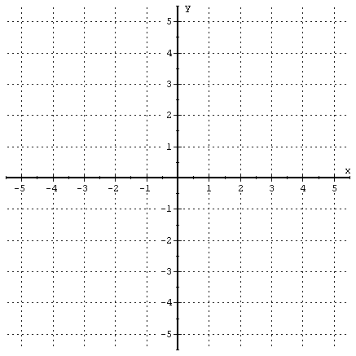
Proportional or Non-Proportional?
Examining a Graph:
Which situation shows a proportional relationship and which one shows a non-proportional relationship? Why?
Graph A
Graph B
Graph A: Non-Proportional A non-proportional LINEAR RELATION is a LINE that does NOT pass through the origin.
Graph B: Proportional A proportional LINEAR RELATION is a LINE that passes through the origin!

Slide 5
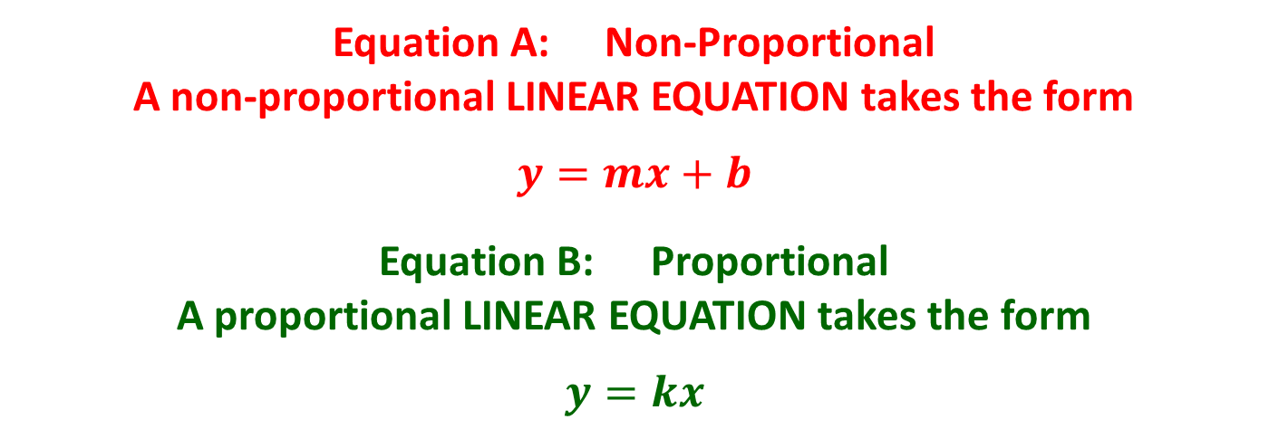
Proportional or Non-Proportional?
Examining an Equation:
Which situation shows a proportional relationship and which one shows a non-proportional relationship? Why?
Equation A: $y=−\frac{5}{7}x+4$
Equation B: $y=3x$
Equation A: Non-Proportional A non-proportional LINEAR EQUATION takes the form
$$y=mx+b$$
Equation B: Proportional A proportional LINEAR EQUATION takes the form
$$y=kx$$

Slide 6
Proportional or Non-Proportional?
Examining a Table:
Which situation shows a proportional relationship and which one shows a non-proportional relationship? Why?
Table A
Table B
x | y
5 | 12.5
7 | 17.5
10 | 25
11 | 27.5
15 | 37.5
x | 4 | 5 | 7 | 10 | 12
y | 7 | 9 | 13 | 19 | 23
Table A: Proportional
A LINEAR proportional table shows:
a CONSTANT RATE OF CHANGE
includes the ORIGIN (0,0)
the RATIOS ARE EQUIVALENT
CROSS PRODUCTS ARE EQUIVALENT
Table B: Non-Proportional
A LINEAR non-proportional table shows:
a CONSTANT RATE OF CHANGE
does not include the origin
the ratios are NOT equivalent
cross products as NOT equivalent

Slide 7
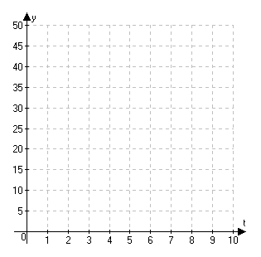
Comparing Proportional & Non-proportional Situations
Tom & Jerry want to go to a fair on Saturday. Based on the information below, compare and contrast the two situations. In both situations, x represents the number of tickets and y represents the total cost for the day.
Cat City Fair
Old Town La Quinta Fair
$$y=3x$$
Which situation is proportional? Why?
What does the graph tell you?
What does the equation tell you?
Which is the better deal to start?
Will that it always be the better deal?
If not, when will it change?
Cost
Number of Tickets

