Slide 1
ANALYZING GRAPHS
Essential Question?
How can you describe a relationship given a graph and how can you sketch a graph given a description?
8.F.5

Slide 2
Common Core Standard:
8.F.5 ─ Define, evaluate, and compare functions.
Describe qualitatively the functional relationship between two quantities by analyzing a graph (e.g., where the function is increasing or decreasing, linear or nonlinear). Sketch a graph that exhibits the qualitative features of a function that has been described verbally.

Slide 3
Objectives:
To sketch and interpret qualitative graphs.

Slide 4
Curriculum Vocabulary
Qualitative graph (gráfica cualitativa):
A graph that represents a function visually, not with numbers.

Slide 5
ANALYZING GRAPHS
You know how to interpret slope and y-intercept in graphs of linear functions. Take a look at this problem.
Each graph shows distance as a function of time. One graph shows the function when Mr. Amplo is driving in his neighborhood. The other graphs represent Mr. Amplo driving on major city streets and highways. Which description matches each graph below?
Graph A
Graph B
Graph C
240
200
160
120
80
40
240
200
160
120
80
40
240
200
160
120
80
40
Distance (Miles)
Distance (Miles)
Distance (Miles)
(1,30)
(1,40)
(1,60)
1 2 3 4
1 2 3 4
1 2 3 4
Time (h)
Time (h)
Time (h)

Slide 6
ANALYZING GRAPHS
Graph A
Graph B
Graph C
240
200
160
120
80
40
240
200
160
120
80
40
240
200
160
120
80
40
Distance (Miles)
Distance (Miles)
Distance (Miles)
(1,30)
(1,40)
(1,60)
1 2 3 4
1 2 3 4
1 2 3 4
Time (h)
Time (h)
Time (h)
What is the slope of each graph? Graph A:___ Graph B:___ Graph C:___
What does the slope mean in each of the graphs?
Which graph has the least steep slope? What is the car’s speed?
Which graph has the next steepest slope? What is the car’s speed?
Which graph has the steepest slope? What is the car’s speed?
Use this information to match each graph to a type of road in the problem.

Slide 7
ANALYZING GRAPHS
The graph to the right represents Mr. Amplo’s drive to work.
This is called a qualitative graph because it describes a function visually, not with exact numbers. The sections labeled A, B, and C have the same slope as the graphs with the corresponding letters on the previous page. Qualitative graphs can have sections with horizontal segments. In this case the horizontal segments mean that there is no change or movement.
This might mean that Mr. Amplo stopped somewhere along the way.
Distance (Miles)
C
B
A
Time (h)

Slide 8
ANALYZING GRAPHS
Qualitative graphs can also have curved lines to indicate that the slope, or rate of change, is not constant. The graph to the right shows the number of students who are in the school cafeteria between 11:00 am and 1:00 pm one school day.
Students go in and out of the cafeteria without following any pattern. The rate is not constant, so this is not a linear situation. The graph shows the following:
The number of students in the cafeteria builds gradually until about 12:00.
Between about 12:00 and 1:00 the number of students in the cafeteria decreases gradually.
Number of Students
in Cafeteria
11:00
1:00
Time

Slide 9
ANALYZING GRAPHS
This graph represents a person tossing up a basketball and letting it bounce on the ground. Describe how the graph represents this situation.
Ball’s distance from the ground
Time

Slide 10
ANALYZING GRAPHS
Describe what each section represents. What could be the explanation for the change in Section 2? Which segment(s) show a decrease in attendance? What could be the explanation?
Explain how the slope of each segment is related to weather attendance increases or decreases.

Slide 11
ANALYZING GRAPHS
Describe the progress represented by each graph.
Determine which graph represents each student.

Slide 12
ANALYZING GRAPHS
Mr. Lopez offers tutoring after school. No one comes the first two weeks of school, but they gradually start showing up after that for a few weeks until there are a steady number of attendees. This stays the same until two weeks before the end of the trimester when there is a rapid increase of students who show up for help. After the trimester is over, the number of students immediately returns to the steady number it was before.
Sketch a qualitative graph to represent this situation.

Slide 13
ANALYZING GRAPHS
SPEED/TIME
DISTANCE/TIME
SPEED
DISTANCE
TIME
TIME
A HORIZONTAL LINE means:
A HORIZONTAL LINE means:
CONSTANT SPEED
RESTING / NOT MOVING

Slide 14
ANALYZING GRAPHS
SPEED/TIME
DISTANCE/TIME
SPEED
DISTANCE
TIME
TIME
A POSITIVE SLOPE LINE means:
A POSITIVE SLOPE LINE means:
STEADILY INCREASING SPEED
A steeper line means a faster speed
MOVING AWAY FROM
A steeper line means a greater distance travelled

Slide 15
ANALYZING GRAPHS
SPEED/TIME
DISTANCE/TIME
SPEED
DISTANCE
TIME
TIME
A NEGATIVE SLOPE LINE means:
A NEGATIVE SLOPE LINE means:
STEADILY DECREASING SPEED
A steeper line means a faster speed
MOVING TOWARDS / RETURNING TO
A steeper line means a greater distance travelled

Slide 16
ANALYZING GRAPHS
SPEED/TIME
DISTANCE/TIME
SPEED
DISTANCE
TIME
TIME
A VERTICAL LINE means:
A VERTICAL LINE means:
SUDDEN STOP
INSTANT RETURN TO START

Slide 17
ANALYZING GRAPHS
SPEED/TIME
DISTANCE/TIME
SPEED
-or-
DISTANCE
-or-
TIME
TIME
An UPWARD CURVE means:
An UPWARD CURVE means:
GRADUALLY CHANGING SPEED
Increasing Variable Rate of Speed
GRADUAL change in distance moving away with an increasing/decreasing rate of speed

Slide 18
ANALYZING GRAPHS
SPEED/TIME
DISTANCE/TIME
SPEED
-or-
DISTANCE
-or-
TIME
TIME
A DOWNWARD CURVE means:
A DOWNWARD CURVE means:
GRADUALLY CHANGING SPEED
Decreasing Variable Rate of Speed
GRADUAL change in distance moving toward / returning with an increasing/decreasing rate of speed

Slide 19
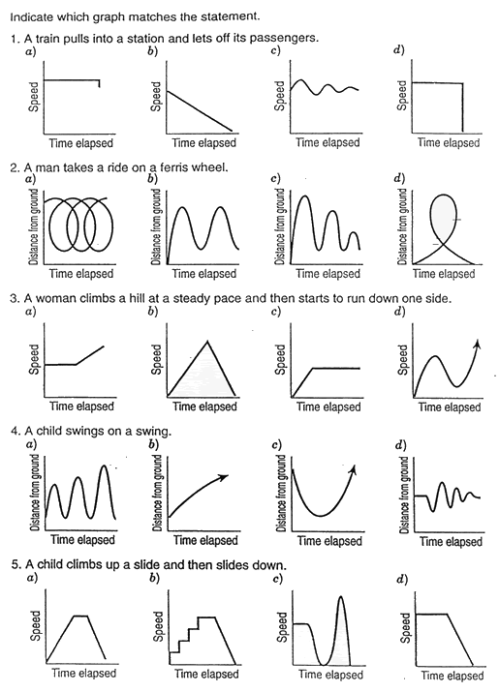
Qualitative representations.

Slide 20
Qualitative representations.
Notes:
TEACHER NOTE: There is no correct answer provided for question 5. You may choose to change the answer key or discuss how to revise the answers to make one of them correct. Choice c would be the best option available (assuming the child walks steadily to the slide, runs up, stops to sit, slides down and stops)
Choice a) Change the y-axis to distance from the ground.
Choice d) Change the slope of segment 2 from negative to positive (speed would increase as the child was sliding)

Slide 21
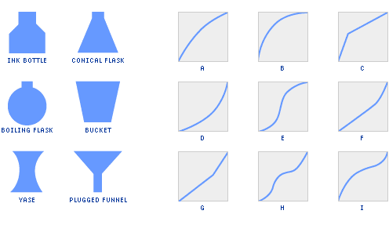
Qualitative representations.
Imagine filling each of the six bottles below, pouring water in at a constant rate. For each bottle, choose the correct graph, relating the height of the water to the volume of water that's been poured in.
For the remaining three graphs, sketch what the bottles should look like.

Slide 22
Qualitative representations.

Slide 23
Qualitative representations.

